Slide 1
Predictive Modeling and Data Mining
Week 1

Slide 2
Work load and Evaluation
A mix between theory and lab work
10 Marked labs
Lab Assignments 65% Labs (See deadlines)
Report + presentation 35% (See deadlines)

Slide 3
Course Objective
The course will introduce predictive modelling techniques as well as related statistical and visualization tools for data mining.
The course will cover common machine learning techniques that are focused on predictive outcomes.
Students will learn how to evaluate the performance of the prediction models and how to improve them through time.

Slide 4
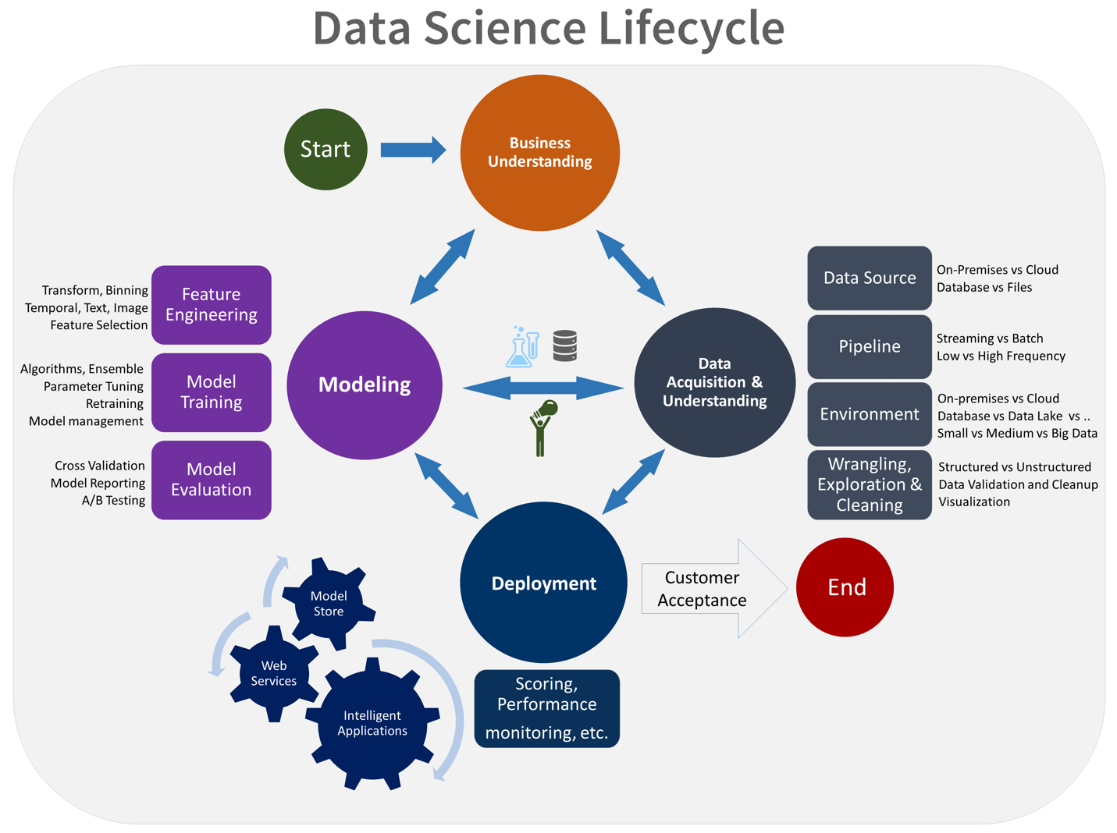
Course Objective

Slide 5
What’s Data: Definitions
Data: Value that is measured (continuous, e.g 25, 100) or counted (discrete, e.g male, married, 5). Data by itself does not have a meaning.
Information: Interpreted data- adding meaning to data, understanding relations on data. e.g measured data is 25, measuring device is thermometer then the reading is temperature. The attribute temperature adds a meaning to the data.
Knowledge: extracting from information rules, patterns, generalization. e.g if humidity is high and temperature is warm and air pressure is above 100 then it will likely rain.
Wisdom: understanding the principles embodied in the knowledge to make judgment or decisions. e.g if you expect rain then take an umbrella with you.

Slide 6
What’s Data
Data Modeling: Creating a structure, organization, function or an abstract view of the data.
Data Analysis: Transforming or operating on data to extract useful information, knowledge or conclusions
Data Mining: Carrying this further to discover unforeseen or hidden patterns in the data.
Definitions provided by in Prof. Mohamed Kamel lecture notes, uwaterloo

Slide 7
Data Modeling
Data Modeling
Descriptive Models
Predictive Models
Assoc Rules
Clustering
Summarization
classification
Time series
Regression
Predictors

Slide 8
Descriptive versus Inferential Analysis
We have data (samples). This data is a sample of a population (more than just the measured or observed sample).
Descriptive Analysis is the type of analysis and measures to describe and summarize the data in hand, the available samples. We can not, in general, use it to for interpretation of unobserved data.
Inferential Analysis (predictive) is the type of analysis that can describe measures over the population of data. That is observed and unobserved.
Take for example calculating the mean of a sample. It is correct for just the sample but it is descriptive of the sample. For inferential analysis it can be only an estimate of the mean of a population that has a slight variation of the sample.
Definitions provided by in Chan et al.

Slide 9
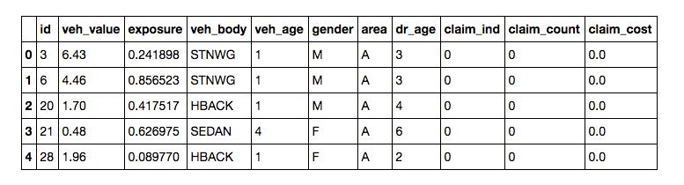
What is Predictive modeling?
Predictive modeling is a process that uses data mining, statistics and probability to predict a set of variables (i.e. response variables) based on another set of variables (i.e. predictors).
Example: Predictive Modelling is utilised in vehicle insurance to assign risk of incidents to policy holders from information obtained from policyholders. The general form of the data set here is as

Slide 10
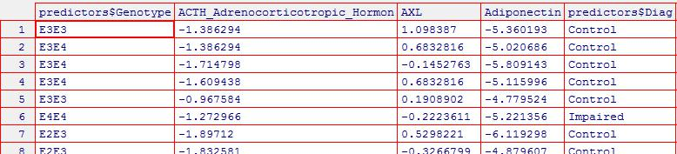
What is Predictive modeling?
The usual response variable is claim cost and we can use the first seven variables as predictors.
Example: Washington University conducted a clinical study to determine if biological measurements made from cerebrospinal fluid (CSF) can be used to diagnose or predict Alzheimer’s disease (CraigSchapiro et al. 2011).

Slide 11
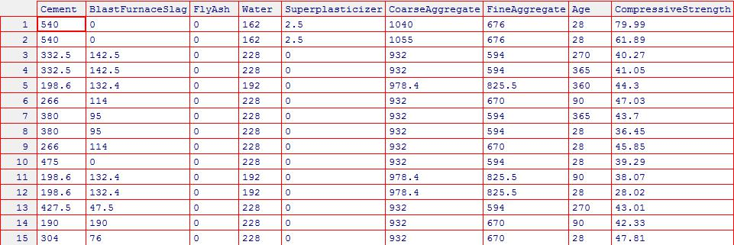
What is Predictive modeling?
The usual response variable is predictor$Diag and the rest can be used as predictors.
Example: Prof.Yeh (1998) describes a collection of data sets from different sources that can be used for modeling the compressive strength of concrete formulations as a functions of their ingredients and age.

Slide 12
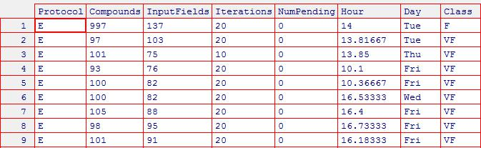
What is Predictive modeling?
Example: (scheduling Data) These data consist of information on 4331 jobs in a high performance computing environment. Seven attributes were recorded for each job along with a discrete class describing the execution time. The predictors are: Protocol (the type of computation), Compounds (the number of data points for each jobs), InputFields (the number of characteristic being estimated), Iterations (maximum number of iterations for the computations), NumPending (the number of other jobs pending at the time of launch), Hour (decimal hour of day for launch time) and Day (of launch time). The classes are: VF (very fast), F (fast), M (moderate) and L (long).

Slide 13
In the course:
In this course we will go through various predictive methods and algorithms. We will talk a little about the other steps mentioned in the previous slides, such as preparing data.
In this course, we use python. It is faster than R.
By the end of the course you should be able to build and deploy predictive models in practice and build on the understanding that you gained in BDA 101 of the underlying concepts in predictive modelling.

Slide 14
First part of assignment 1
At the first part of assignment 1, we need to install various packages. Let’s install them and look at their descriptions.
There are different methods to import python packages into your environment:
Import ‘package-name’
Import ‘package-name’ as ‘some name’
From ‘package-name’ import *
From ‘package-name’ import ‘specific function’

Slide 15
Second part of assignment 1
In the second part of assignment 1, we need import the packages that we installed before and run some basic commands to get used to these packages.
For the remainder of this lesson, please work on assignment 1. Your solutions may be uploaded to Avenue to Learn for feedback. Note that today’s assignment does not have any weight in the final grading scheme.
However, Assignment 1 forms an important basis of knowledge for the remaining assignments that will be included in your final grade. We have found that students who did not complete assignment 1 were unable to complete future assignments in a timely manner.

Slide 16
Appendix

Slide 17
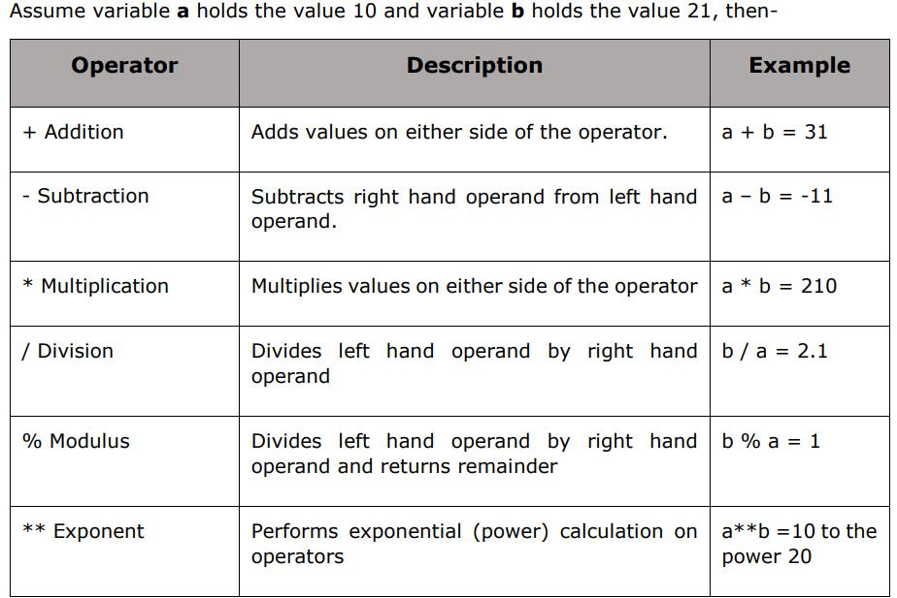
Python warmup: Basics
1. Arithmetic Operators:

Slide 18
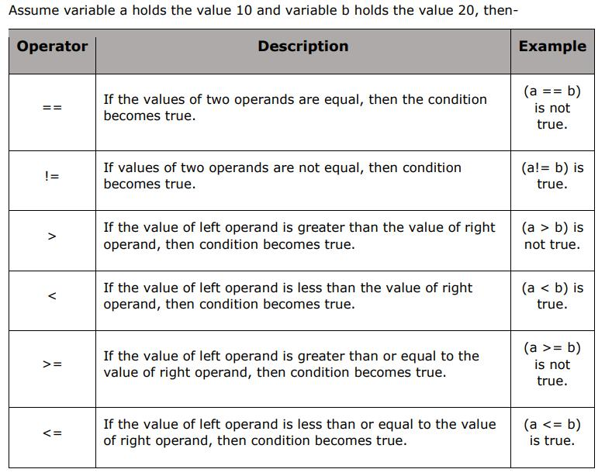
Python warmup: Basics
2. Logical Operators:

Slide 19
Python warmup
You can use any IDE for python in this course.
A popular IDE is PyCharm
There is also Spyder
For fast development and idea proofing you can use Jupyter Notebook
For this course I suggest that you use either Jupyter Notebook or PyCharm

Slide 20
Python warmup: Pycharm
First let’s create a folder on desktop and call it python. This folder will be your working directory.
Let’s open your IDE of choice and look at the environment.
Now type the following in the new window:
a=2
b=3
c=a+b
print(c)
Run your code/cell
Now let’s write and execute the following commands:
a="Hello“
b=" BDA 104“
c=a+b
print(c)

Slide 21
Python warmup: Basics
Variables: To assign a variable in python use the following format:
“name of variable”=“value of variable”
Example: a=2
Variable type:
Numbers: Python supports three different numerical types
Int (integer): 2,123,-8
Float (decimal): 0.02,-1.43
Complex : 2-3j, 43+98j
Strings: Strings in Python are identified as a contiguous set of characters represented in the quotation marks. For example, “Hello” is a string. Subsets of strings can be taken using the slice operator ([ ] and [:] ) with indexes starting at 0 in the beginning of the string and working their way from -1 to the end.
Type str = “BDA is Awesome!” into your IDE console and select some subsets from the string

Slide 22
Python warmup: Basics
The plus (+) sign is the string concatenation operator and the asterisk (*) is the repetition operator. For example:
str = 'Hello World!’
print (str) # Prints complete string
print (str[0]) # Prints first character of the string
print (str[2:5]) # Prints characters starting from 3rd to 5th print
(str[2:]) # Prints string starting from 3rd character
print (str * 2) # Prints string two times
print (str + "TEST") # Prints concatenated string
3. Lists: Lists are the most versatile of Python's compound data types. A list contains items separated by commas and enclosed within square brackets ([]). To some extent, lists are similar to arrays in C or R. The values stored in a list can be accessed using the slice operator ([ ] and [:]) with indexes starting at 0 in the beginning of the list and working their way to end -1.

Slide 23
Python warmup: Basics
The plus (+) sign is the list concatenation operator, and the asterisk (*) is the repetition operator. For example
list = [ 'abcd', 786 , 2.23, 'john', 70.2 ]
tinylist = [123, 'john’]
print (list) # Prints complete list
print (list[0]) # Prints first element of the list
print (list[1:3]) # Prints elements starting from 2nd till 3rd
print (list[2:]) # Prints elements starting from 3rd element
print (tinylist * 2) # Prints list two times
print (list + tinylist) # Prints concatenated lists
Lists have the unique property that they can contain data elements of different types, i.e. strings, numbers (called floats), objects etc.
Create some lists in the console to apply some of the commands above
4. Tuples: A tuple is another sequence data type that is similar to the list. A tuple consists of a number of values separated by commas. Unlike lists, however, tuples are enclosed within parenthesis.

Slide 24
Python warmup: Basics
The main difference between lists and tuples is- Lists are enclosed in brackets ( [ ] ) and their elements and size can be changed, while tuples are enclosed in parentheses ( ( ) ) and cannot be updated. Tuples can be thought of as read-only lists. For example
tuple = ( 'abcd', 786 , 2.23, 'john', 70.2 )
tinytuple = (123, 'john’)
print (tuple) # Prints complete tuple
print (tuple[0]) # Prints first element of the tuple
print (tuple[1:3]) # Prints elements starting from 2nd till 3rd
print (tuple[2:]) # Prints elements starting from 3rd element
print (tinytuple * 2) # Prints tuple two times
print (tuple + tinytuple) # Prints concatenated tuple
tuple = ( 'abcd', 786 , 2.23, 'john', 70.2 )
list = [ 'abcd', 786 , 2.23, 'john', 70.2 ]
tuple[2] = 1000 # Invalid syntax with tuple
list[2] = 1000 # Valid syntax with list

Slide 25
Python warmup: Basics
You can use various functions to different types to each other.
int(x) : Converts x to an integer
float(x) : Converts x to a floating-point number.
str(x) : Converts object x to a string representation.
Python operators:
Arithmetic Operators:

